Slide 1
App 2.0 - why the web lost and Apps won
Liam Westley @westleyl
Application Architect, Huddle liam.westley@huddle.com

Slide 2
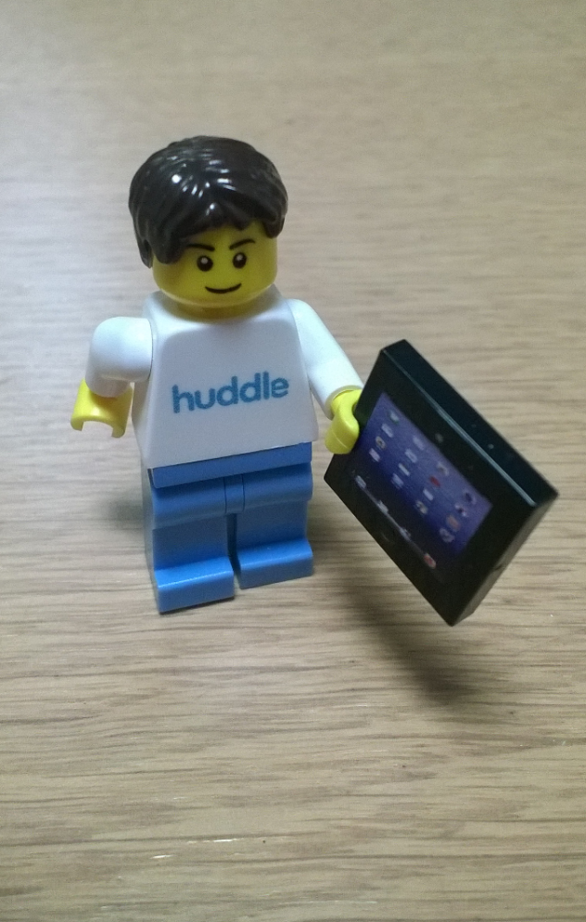
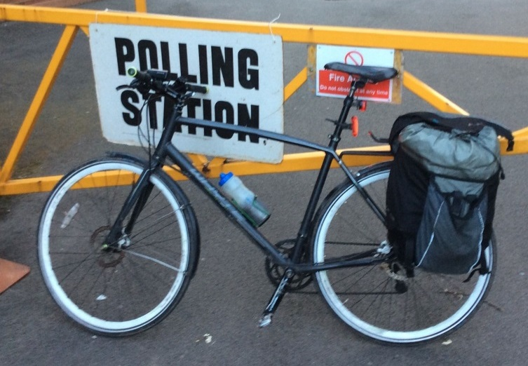

Who is Liam Westley?
< commute
play >
< work
Notes:
Lego minifig Huddle architect courtesy of Betsy Weber, of TechSmith.
Polling Station – London Assembly and Mayoral elections, May 2016.
Egg and Spoon Race – Blists Hill Victorian Town, Ironbridge Gorge Museums, Ironbridge, UK.
http://www.ironbridge.org.uk/

Slide 3
A step back into the past ….

Slide 4

Mainframes
© freeimages.com / Charles Toepfer
Notes:
Apps took a long time to run, often overnight and spat out results (if you were lucky and it didn’t just crash overnight) back onto card or a printout for users to view.

Slide 5
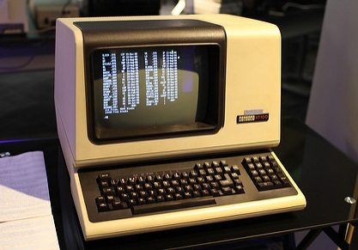
Rise of the terminal
© Jason Scott / flickr
Notes:
Eventually we arrived at applications running on central computer, mainframe or minicomputer with a computer terminal which talked to those applications.
This is a VT100 and when I first worked at Sky News in 1992, the newsroom system still used VT terminals to connect to a system called Basys. That was real thin client computing – terminals were connected by RS232 or RS422 serial connections.

Slide 6
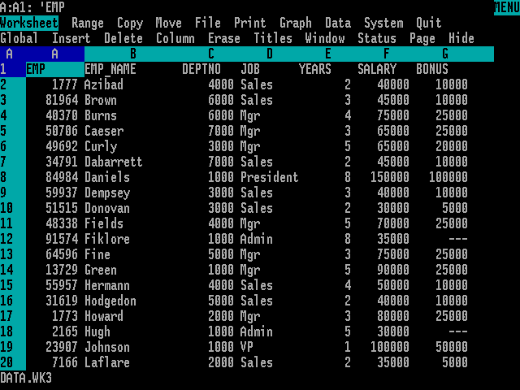
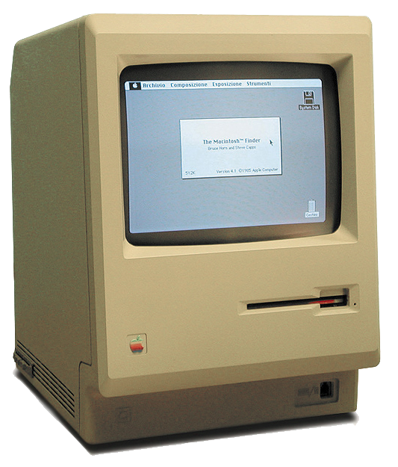
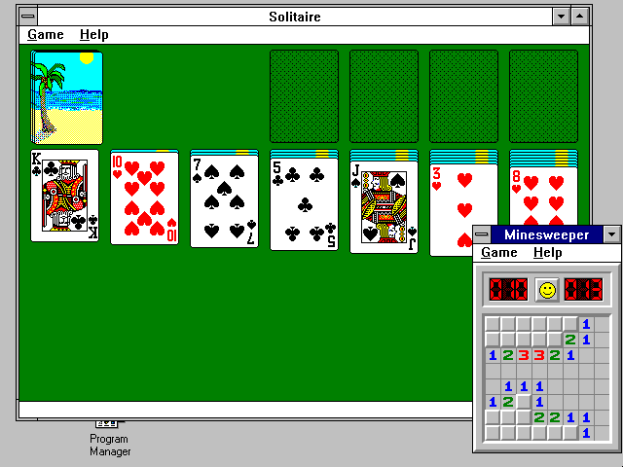
PC – CP/M, DOS, Windows, Apple Mac OS
Notes:
Images from;
Lotus 1-2-3 for DOS
By Source, Fair use, https://en.wikipedia.org/w/index.php?curid=9501792
Apple Macintosh
By w:User:Grm wnr - Modifications of Image:Macintosh 128k.jpg and w:Image:Macintosh 128k No Text.jpg, CC BY-SA 3.0, https://commons.wikimedia.org/w/index.php?curid=519781
Windows 3.1 - ToastyTech blog
http://toastytech.com/guis/win312.html

Slide 7
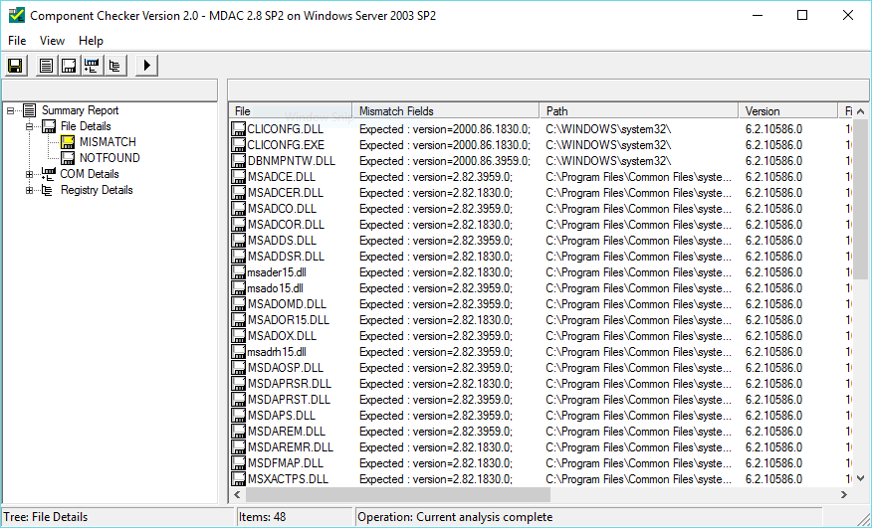
Installs, updates and, with Windows, DLL hell
Notes:
So everything was better – we were installing applications locally and end users had the power, free from the restrictions of the IT department. With great power comes responsibility and soon we were mired in conflicting applications.
ADO.NET – there was even a tool released for Microsoft developers called the MDAC Checker. This validated what DLLs you had on the system for data access and attempted to highlight any incompatibilities caused by different installations, including Visual Basic apps, Access applications and SQL Server clients.

Slide 8




… not forgetting n-Tier Client Server
Notes:
The simple version of n-Tier client server was three tier, with an application running on a desktop communicating with application servers in a middle tier, in turn communicating with a database.
App Servers with Java or DCOM, binary protocol, although towards the end it was also common to communicate using SOAP/XML interfaces.
Very often all three tiers would be within an internal corporate network.

Slide 9
Then everything changed ….
… the Internet arrived

Slide 10
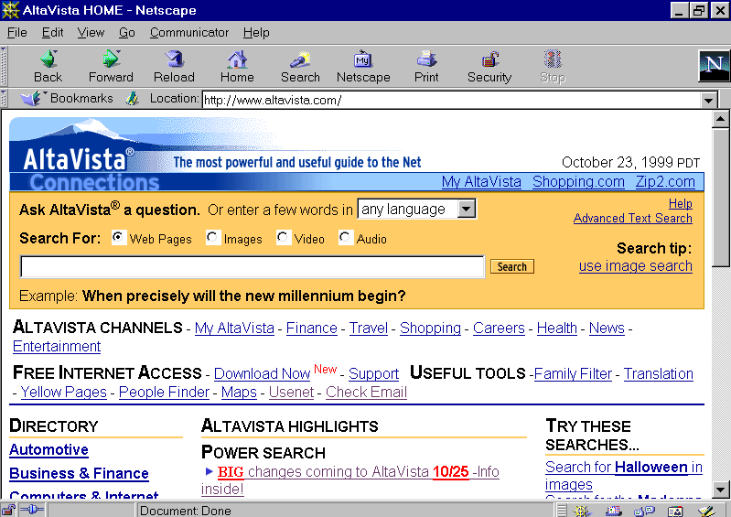
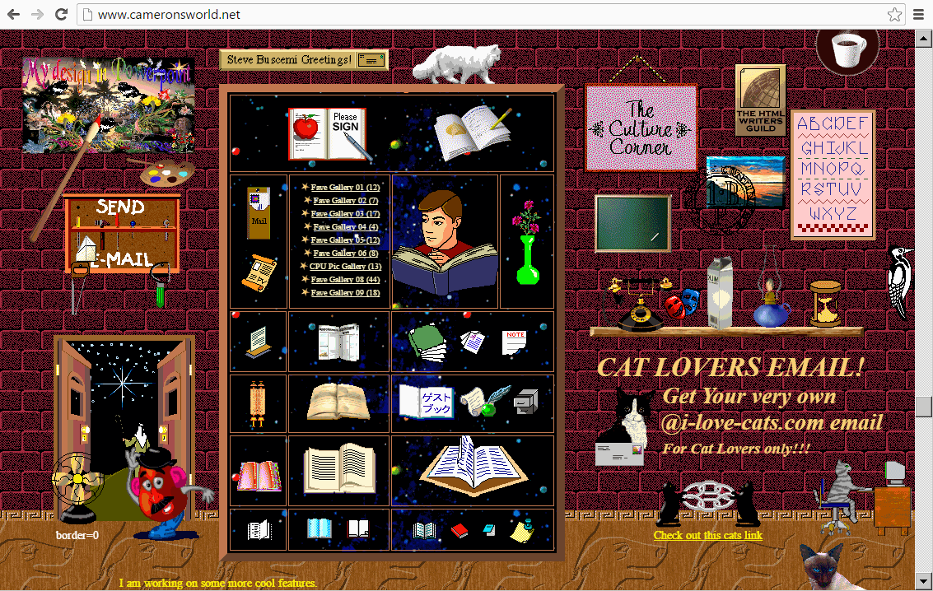
Browse all the things!
Notes:
Alta Vista image from
https://en.wikipedia.org/wiki/AltaVista
GeoCities Remembered image from
http://www.cameronsworld.net/

Slide 11
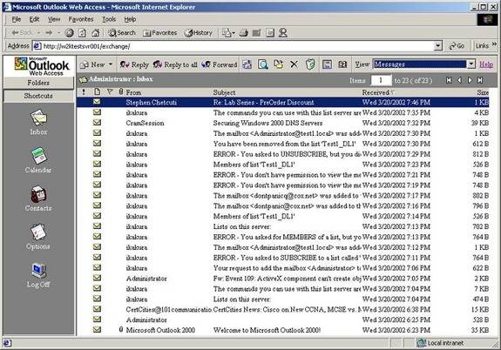
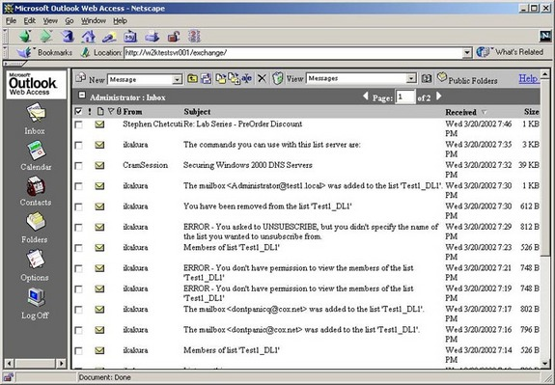
The browser as an application
Notes:
Early 1997 - Outlook Web was an RIA - Rich Internet Application.
Two pillars of Web 2.0, but lacking the social web.
Introduced AJAX – it was the Outlook team who created XMLHTTP requests in IE 5.0.
Jan 1999 Web 2.0 term used.
2004 – first Web 2.0 conference.

Slide 12
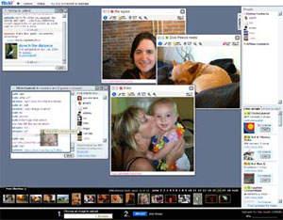
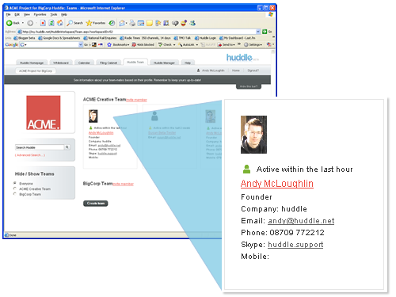
Web 2.0 – Social and rich application
Notes:
Image from Flickr, August 2004
http://web.archive.org/web/20040811073028/http://www.flickr.com/learn_more_5.gne
Image from Huddle, February 2007
http://web.archive.org/web/20070206095744/http://www.huddle.net/tour_7.asp

Slide 13
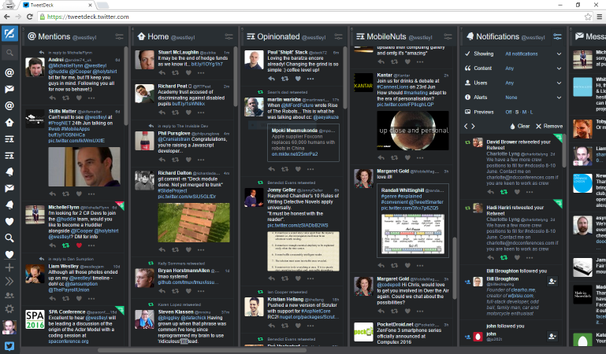
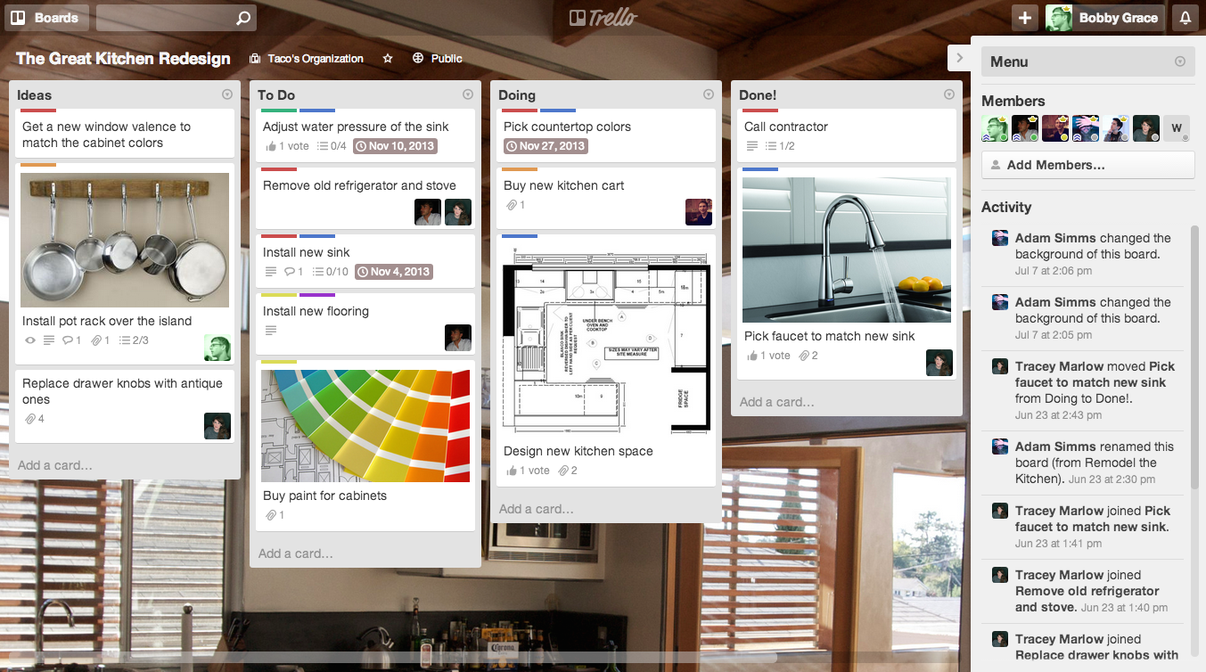
Which brings us to today
Notes:
Tweetdeck – previously an Adobe Air application, now completely hosted in a browser with all the functionality the application previously delivered. Except now it even works on mobile browsers.
Trello – a fantastic example of a Web 2.0 application.
Sharing information, drag and drop interface, cached edits that it fails to save, waiting for the data connection to return.

Slide 14
While this was all going on ….
… the iPhone arrived

Slide 15
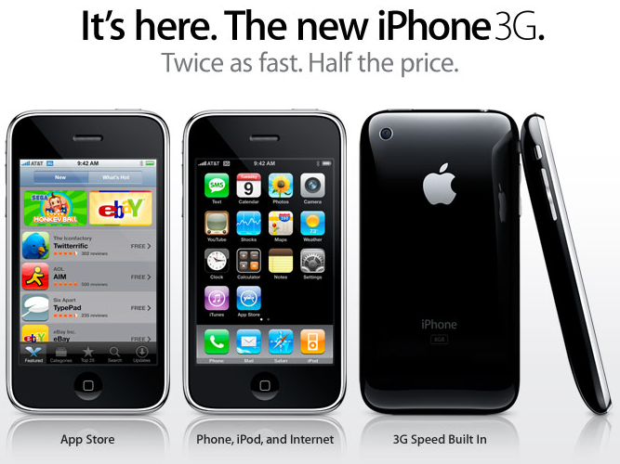
… or more importantly the App Store
Notes:
June 2007 – Original iPhone launched.
July 2008 – iPhone 3G launched AND the App Store.
January 2011 – over 10 billion apps downloaded.
February 2012 – in less than four years, over 1 million apps in the App Store.
No need to download fiddly applications, with a myriad of payment methods.
No need to find the right CPU build (ARM, MIPS, SH3, x86) or run an installer on your desktop that tried to remote install onto your phone.

Slide 16

… and the Android Market – now Google Play
Notes:
October 2008 – a few months after the Apple App Store.
December 2011 – achieved 10 billion downloads 11 months after the Apple App Store.
The easy of installing apps was now the same across iOS and Android, a quick search, and permitting access to the app to various resources on the phone, and your app was installed and ready to go.

Slide 17



… and we’re back to client server
REST API
Notes:
Modern mobile app similar to client server.
App talking to some web servers over the Internet, talks to MySQL, SQL Server, Mongo, or a cache, Redis.
No SOAP, more likely REST API and readable JSON or XML.
And there is some local storage as raw files or in a local database (commonly SQLLite)

Slide 18

In the red corner Web 2.0 ….
… in the blue corner Apps
Notes:
Sound from
https://www.freesound.org/people/Benboncan/sounds/66951/

Slide 19

Discoverability
DRAW
Notes:
Web - Discoverable by Google, or Yahoo!, or Bing, feeds such as Facebook news, reddit, or curated lists on blog sites or lists of tweets in Twitter.
Every link is a valid as any other, which may include phishing or malware attacks.
App Stores provide a level of curation, some better than others. Detecting and removing malicious apps is easier when there is a central directory, and an application submission process.
Curated lists can provide popular and most downloaded applications.
Image from http://maps.google.co.uk with JavaScript disabled;
‘When you have eliminated the JavaScript, whatever remains must be an empty page.’
(Firefox with NoScript add-in has this effect)

Slide 20
WEB 1 – 1 APPS
Notes:
Sound from
https://www.freesound.org/people/Benboncan/sounds/66951/

Slide 21

App Store revenue
APPS WIN
Notes:
App Stores – purchase both full apps and in app purchases.
Not limited to credit card payments, operator billing, pre paid cards for children.
In-app now approaching 50% of total app revenue.
By 2017 – $28.9 billion of in-app purchases world wide.
Web has promised but failed to create micro payments, either for leisure or information.
E-commerce payment systems are many and varied and not all are suitable for micro payments.
Apple Pay and Google Pay may help and break out from just replacing contactless credit cards.
2017 – Total app revenue from $45,37B in 2015 to $76.52B in 2017
2017 – In-app share – 48.2%
2020 – Apps contribution to iTunes revenue 20%

Slide 22
WEB 1 – 2 APPS
Notes:
Sound from
https://www.freesound.org/people/Benboncan/sounds/66951/

Slide 23
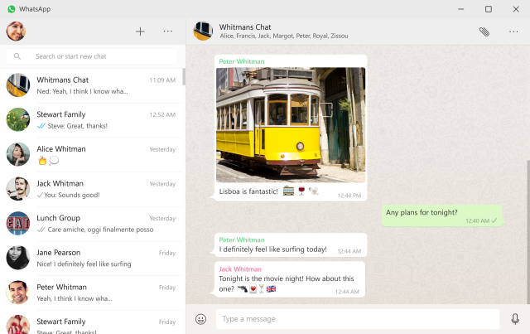
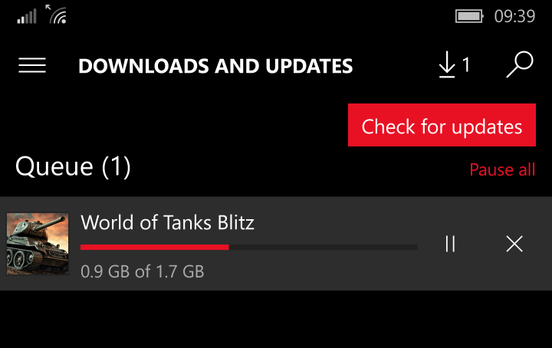
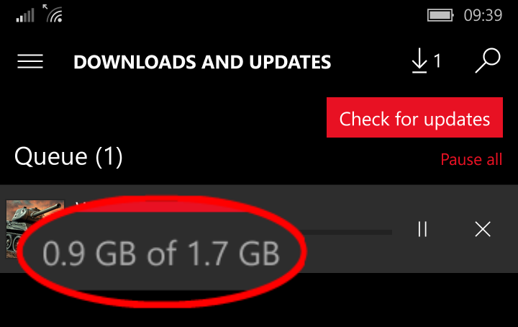
Local installation
APPS WIN
Notes:
WhatsApp has a desktop app – only a skin on the web app.
End to pairing your phone repeatedly, keep it separate from other browsing and less likely to be forgotten.
World Of Tanks Blitz is a full 3D game – iOS, Android, Mac desktop and Windows 10 (including mobile) – it clocks in as a 1.7Gb download. This is well beyond any local browser storage.
.

Slide 24
WEB 1 – 3 APPS
Notes:
Sound from
https://www.freesound.org/people/Benboncan/sounds/66951/

Slide 25

No installation
WEB WINS
Notes:
Web Tweetdeck –no sense offline, a tool for multiple streams of live content
Apps Android Instant Apps – no App Store to visit and smaller installations
Push installation from a Bluetooth beacon
Google IO in May - Instant Apps feature for Android.
Partial app download without going to the App Store.
Removes the 'is the app installed or not when we link to it?' problem.
Challenges a major premise behind chat bots (they don't require you to install a new app).

Slide 26
WEB 2 – 3 APPS
Notes:
Sound from
https://www.freesound.org/people/Benboncan/sounds/66951/

Slide 27
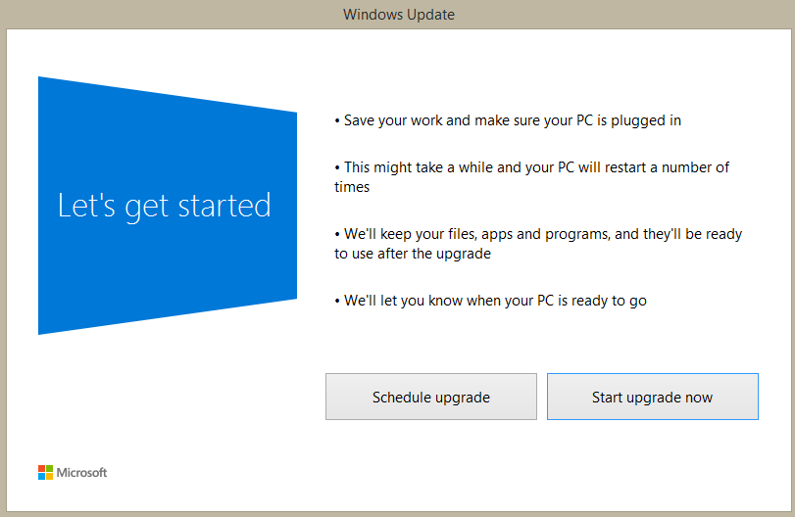
Updates
WEB WINS
Notes:
Windows 10? Did it download over 3Gb in the background and then throw up this dialog?
Upgrades hurt, even mobile apps can easily come in at 100Mb, which for people with a 1Gb data allowance is bad news, and may even by an issue over WiFi with a monthly broadband limit.
BUG FIXES are hard in apps – updates require testing, submission to an app store to start an approval process (a day for Android, a week for Apple) and no easy way to pull a release if it goes wrong.
Web applications are on a server, and can be updated immediately.
Feature switching can and A/B testing is made easy without hacks inside the app to take a different code path.

Slide 28
WEB 3 – 3 APPS
Notes:
Sound from
https://www.freesound.org/people/Benboncan/sounds/66951/

Slide 29

Local storage
APPS WIN
Notes:
Web –mobile browsers constantly prompting users for increasing the amount required, FT HTML app had issues with this, users less and less likely to say YES.
Without local storage web apps are like goldfish, every time you head back into a web page it’s like it’s forgotten everything that went before. Not quite, browsers have cookies and content can come from the local cache.
FT HTML5 app has to keep requesting permission for more storage. Users less likely to say YES
Apps - local storage in secure sandbox areas, removed when app is uninstalled, capable of using as much storage as required (which may be a bad thing on a low end phone with not much space).

Slide 30
WEB 3 – 4 APPS
Notes:
Sound from
https://www.freesound.org/people/Benboncan/sounds/66951/

Slide 31
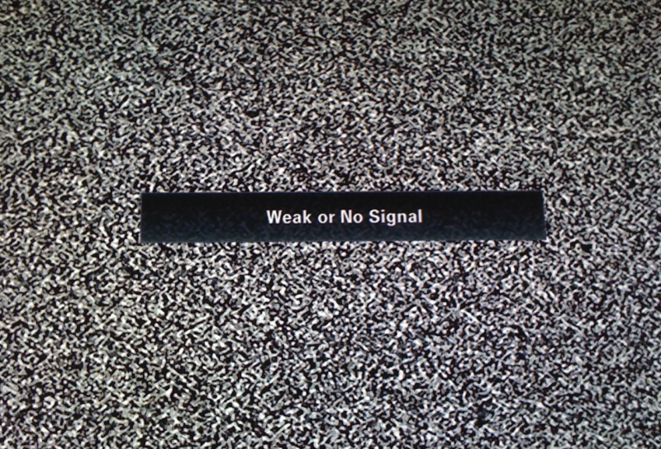
Disconnected Use
APPS WIN

Slide 32
WEB 3 – 5 APPS
Notes:
Sound from
https://www.freesound.org/people/Benboncan/sounds/66951/

Slide 33
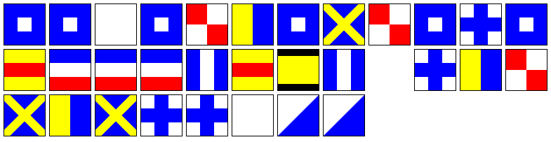
Notifications
APPS WIN
Notes:
Battle of Trafalagar – ‘England Expects That Every Man Will Do His Duty’
Notifications using Amazon AWS Mobile Services – can send to iOS, Android or Windows devices, free for 1,000,000 messages per month.
Web/HTML Notifications good for desktop, except Internet Explorer (latest Edge has support) – but no presence on iOS Safari or Chrome for Android.
Roost provides a method for web notifications, including off site notifications. Paid for service but can extend to notification centre on Windows and OS/X desktops as well as mobile support.

Slide 34
WEB 3 – 6 APPS
Notes:
Sound from
https://www.freesound.org/people/Benboncan/sounds/66951/

Slide 35

Linking … going deep
DRAW
Notes:
Web apps – ability to link from one page to another very quickly, jumping to internal content without having to navigate through multiple stages as well as linking to external content.
Apps - custom schemas, like huddle:// create deep linking straight into applications.
Similar mechanism without the need to route via a browser.
Apps can directly link to one another; used by Office for iOS to support editing via Office Online.

Slide 36
WEB 4 – 7 APPS
Notes:
Sound from
https://www.freesound.org/people/Benboncan/sounds/66951/

Slide 37


Show me the money!
WEB WINS
FOR NOW !
Notes:
eCommerce - Dominos pizza
E-commerce sales now account for 77.7% of all UK deliveries and 48.6% of online sales are made using its app.
Domino's says online orders in the UK rose by nearly 29% last year and app-based orders shot up by more than 41%, with 11.5 million people now having downloaded the app in total.
http://www.bbc.co.uk/news/business-35714501
In App purchases
The number of apps in Google’s Play Store that charge for download has decreased in 2015.
Upgrades, where a free application will offer users the possibility to upgrade to a more enhanced or ad-free version of their product in exchange of a fee. The most widely used revenue stream is advertising, but, according to developers, also the most hated.
The monetization model said to be the most profitable for mobile developers, is the in-app purchase, although only an estimated 15 percent of smartphone users have made such a payment.

Slide 38
WEB 5 – 7 APPS
Notes:
Sound from
https://www.freesound.org/people/Benboncan/sounds/66951/

Slide 39
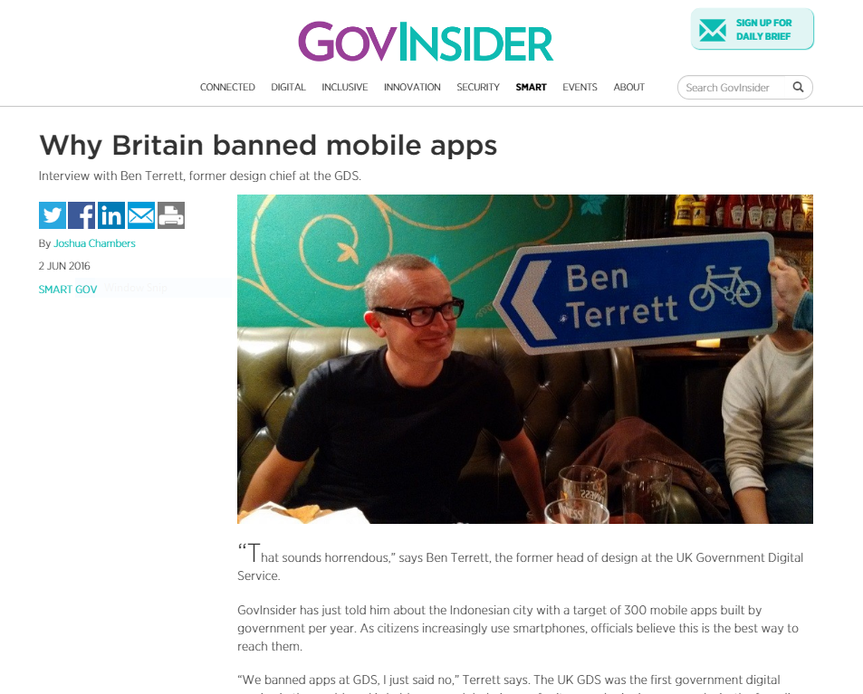
Lose me some money!
WEB WINS
ADAPTIVE !
Notes:
UK Government doesn’t do apps, interview with Ben Terrett, former design chief at the GDS (Government Digital Service);
https://govinsider.asia/smart-gov/why-britain-banned-mobile-apps
Adaptive apps can provide the answer to deploying the web to mobile. There are poor examples of adaptive applications that don’t really work, which provide ammunition for the Apps camp that the web doesn’t work on mobile. However, when treated as a first class citizen within the web team, as the GDS shows, it can provide widest reach of devices and customers.

Slide 40
WEB 6 – 7 APPS
Notes:
Sound from
https://www.freesound.org/people/Benboncan/sounds/66951/

Slide 41
Aren’t App Stores old hat though?

Slide 42
App saturation
50,000
0
Number of apps submitted to the
App Store in January 2016
Number of apps downloaded in that
month by the majority of users
Notes:
In January 2016 over 50,000 apps were submitted to the app store. However, most smartphone users download zero apps per month.
https://medium.com/art-marketing/the-hidden-homescreen-70c794ff9ada#.8o3klbpxd

Slide 43
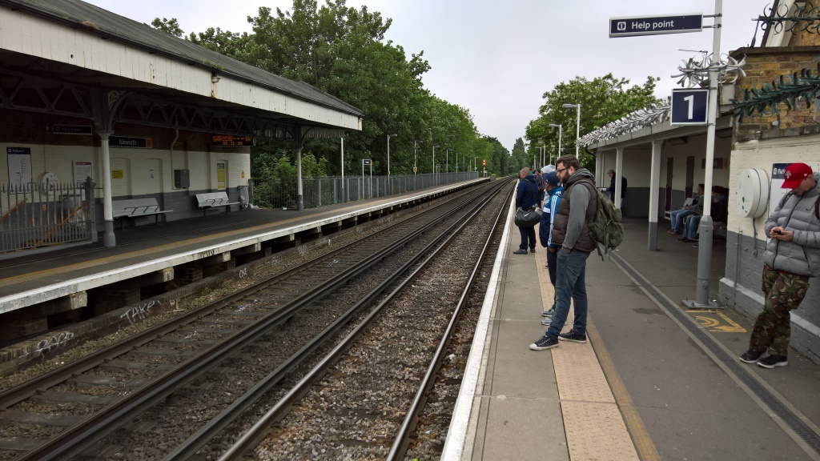
Platforms
Notes:
Platforms? O/S? Windows, iOS, Android, OS/X, Linux.
Browsers as a platform – with the JavaScript engines and tab isolation they are virtual machines.
Cross platform frameworks to write once and deploy on multiple platforms – the new Instagram for Windows Mobile is a direct port of the iOS version – so direct the buttons and UI are all iOS based.
Applications as a platform, Facebook Messenger, WhatsApp, Skype are all supporting bots and chat interfaces.
Cloud services such as AWS and Azure are the platform, critical to IoT with no user interfaces to speak of. Speech control and AI then become dependent on the cloud platform, irrespective of the source device.
New computing eras have occurred every 10–15 years – time for a change from Mobile?

Slide 44

It’s good to talk
Notes:
The Future of Conversational UI Belongs to Hybrid Interfaces
2016 is the year of everything conversational. Messaging apps are taking over the world and app store rankings with incredible retention and engagement rates.
Conversational UI – blending in messaging or voice interaction with simple commands, and simple, mostly textual responses, occasionally paired with a photo.
Really? 1986, 1996, 2006 were also the years of everything conversational. To learn where conversational UI should go in the future, we should draw from this rich history.
Command-line – aka the original conversational interface

Slide 45
AI - Artificial Intelligence
'The computer can ask fewer questions and work out more by itself.'
Notes:
There’s an old computer science idea that a computer should never ask a question that it should be able to work out the answer to.
Chat bots, conversation and AI as an interface
Challenge in plugging an AI into a 'conversational' chat bot interface is that you don't have HAL 9000 from 2001 A Space Odyssey. You speak to it, it speaks back, and it uses natural language (either in voice or text), but it isn't general AI at all. So, how likely is it that the users can ask something that breaks it? How badly?
Can you get people to accept the domain?

Slide 46




Rise of the bots
Notes:
AI is required to make sensible Bots; infamous Twitter bot Tay from Microsoft Research.
Designed as a teenage girl who learnt and reflected on Twitter so accurately, within 24 hours it became a holocaust-denying racist.
Of course, this says a whole lot more about the content on Twitter than the AI used to program Tay.
Bots and Chat Interfaces are not the same thing, but are related.
Bots are chat-based conversations between a user and an automated response system. No humans.
Chat interfaces are a superset of this — any app where the user interface looks more like messaging than point-and-click.

Slide 47
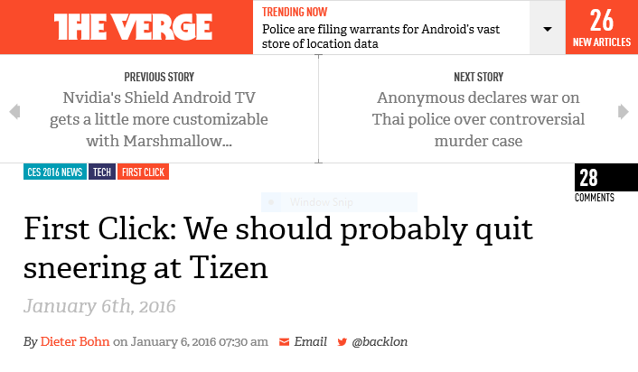
Narrow focus apps
Notes:
First Click: We should probably quit sneering at Tizen – why it works for watches, televisions and fridges better than Android.
Tizen is never going to unseat Android or iOS — I don't think it's ever likely to be a viable contender if you judge it in the way we've traditionally judged platform battles.
But Samsung doesn't need to fight that battle. It just needs an invisible OS that allows it to rapidly create compelling, integrated features that consumers will enjoy.

Slide 48

No UI ?
Notes:
Amazon Echo with Alexa assistant. Siri, Cortana, Google Assistant (more than just Google Now)
Lightbulbs, fridges, washing machines – what interface do they have, not always touch, may be gestures or simple buttons.

Slide 49
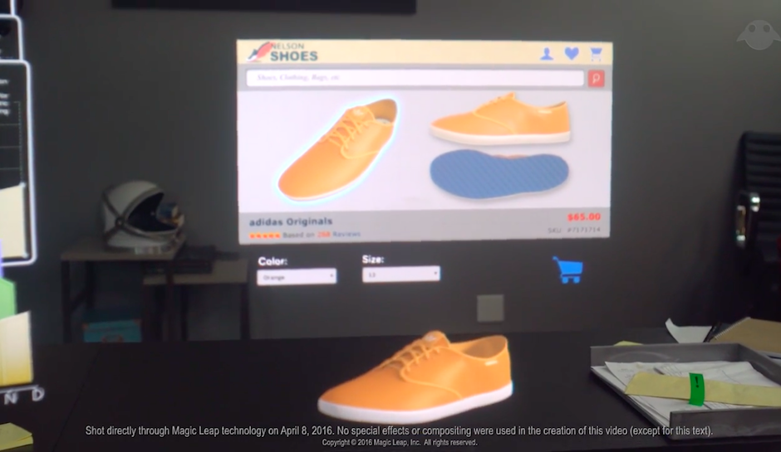

AR and VR
Notes:
Or a completely immersive UI.
Prediction of Virtual Reality (Occulus Rift, Google cardboard), and the more usable Augmented Reality (such as Magic Leap and HoloLens).
AR – this is the addition of computer generated data and images to a view of the real world.
Google Glass – contextual information presented over the real world.
AR generally is not just data, rendering realistic objects within the real world, acting as interaction points. (Minority Report)
VR – limited by computing power. Processing power and fidelity of graphics may be solved, but are we sure the world will be filled with people wearing Google Cardboard (or some more fashionable hardware) outside of gaming and 3D visualisations?

Slide 50
So maybe the future is Apps 2.0

Slide 51

Notes:
Image from
http://www.screwfix.com/p/british-general-45a-1-gang-double-pole-cooker-switch-white/45659
Sound from
http://www.soundjay.com/switch-sounds-1.html

Slide 52
App 2.0 - why the web lost and Apps won
Liam Westley @westleyl
Application Architect, Huddle liam.westley@huddle.com

